Slide 1
SENSOR STATION
Shreenithi Madhavan
Shreshth Khosla

Slide 2
INTRODUCTION
Our project aims to measure the data such as temperature and humidity from a sensor and display it through the OLED screen. This sensor station can be used by households to monitor the weather conditions before going out.
We are using the DHT 22 sensor that measures temperature and humidity from the surroundings.
ESP 32-WROOM-32D is the microcontroller used in this project.

Slide 3

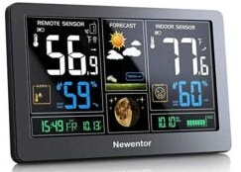
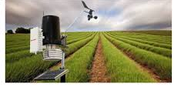
Applications
AVIATION
Before flight take-off, weather checks are done to ensure safety.
HOUSEHOLD DEVICE
Before going out, people check the temperature to dress appropriately or carry an umbrella.
AGRICULTURE
It is useful for the farmers to be aware of dry and wet conditions to plant vegetation accordingly

Slide 4
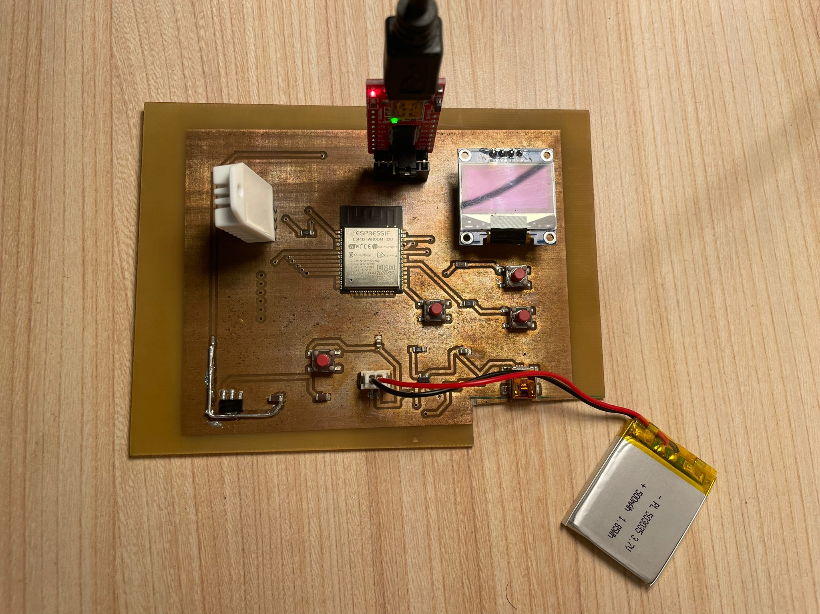
FTDI Module
OLED Display
DHT22 Sensor
ESP32- wroom- 32D chip
Pushbuttons
Mini-USB port
3.7 V Li-ion battery
Voltage regulator AMS3117
Battery management MCP73831
Battery connector

Slide 5
MAIN COMPONENTS
DHT22 Sensor
We have used the DHT 22 sensor, made of a capacitive humidity sensor and a thermistor. It consists of a chip that does analog to digital conversion to display the temperature and humidity with the help of a microcontroller. It is ideal for displaying 0-100% humidity readings with 2-5% accuracy and -40 to 80°C temperature readings with ±0.5°C accuracy.
OLED Display
As the name indicates, it displays the measured data through I2C communication. It conducts electricity to organic materials which are sandwiched between the electrodes for light emission.

Slide 6
Battery Management
We use MCP73831 IC to charge the battery. It is an advanced linear charge management controller which is compact and budget friendly as well. It adopts a constant current/constant voltage circuit to prevent overcharging.
Voltage Regulator
AMS1117-3.3 is a cost-efficient, low dropout (LDO) Voltage Regulator designed to provide a current of up to 1 ampere. The output voltage can vary from 1.5V to 5V. It also has a low dropout voltage of 1.3V when operating at maximum current. The maximum input voltage it can support is 15V. This device is used to obtain a steady voltage of 3.3V from the power source.

Slide 7
FTDI Module
FTDI module uses an FTDI chip that converts the USB signal to a UART (Universal asynchronous receiver-transmitter) signal for our microcontroller to understand. It, therefore, aids in programming the ESP32-WROOM-32D chip using Arduino IDE.
The programming process is automatic. It uses two switches, BC547 transistors, and other components.
The RTS signal is for resetting the ESP and the DTR signal is to put the chip in flashing mode.

Slide 8
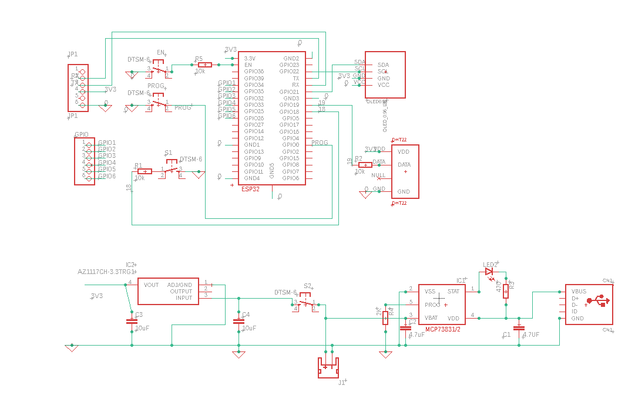
SCHEMATIC DIAGRAM
GND- Ground pin
RX- Input data reception
TX- Output data transmission
Vcc- Input data reception
SDA – Serial data pin for I2C interface
SCL – Serial clock pin for I2C interface
GND – Ground pin
VCC – power supply for display
VDD – Power supply
Data – Outputs temperature & humidity by serial data
GND – Ground pin
Vdd- Battery management input supply
Vbat- Battery charge control output
STAT- Charge status output
PROG- Current regulation set & charge control enable
ADJ/GND- Ground pin
Vout- Regulated output voltage
Input- Input voltage that has to be regulated

Slide 9
METHODOLOGY
The following processes were performed after designing the schematic and board view to successfully manufacture our PCB.
Printing – On a laminated plastic A4 sheet, we printed the top and bottom layers mirrored on each other.
Cutting – The copper-plated board was cut according to the necessary dimensions.
PCB Masking – This board was then placed under UV light for 2 minutes and 30 seconds.
Developing – It was then dipped in a solution of sodium hydroxide.

Slide 10
METHODOLOGY
Etching - The PCB is etched using iron chloride to remove the unprotected copper.
Cleaning – It is then wiped with alcohol to get rid of unwanted residue.
Inspection – We checked the track’s connections to see if everything was etched properly.
Placing & Soldering – We drilled holes for the through-hole components and the vias. Following this, we mounted the SMD components on the board. This board was then put in the oven to fix these components on the PCB. At last, we soldered the THT components.

Slide 11
CONCLUSION
The ideal result after programming the code on Arduino IDE and uploading it to the microcontroller, the temperature (in degrees) and the percentage of the humidity in the environment are detected and displayed on the OLED panel. Although, the desired outcome was not achieved.

Slide 12
FUTURE PROSPECTS
This sensor station could be further advanced to an IoT project. The measured values can directly be displayed to a device with Wi-Fi/Bluetooth enabled by programming the code accordingly. Keeping this in mind, we have also added extra GPIO’s for future expansion.

Slide 13
THANK YOU

